Slide 1

Clinical Trial Diversity Mandates: FDA Requirements vs Economics
Exploration of the complex dynamics between FDA's diversity requirements for clinical trials and the economic factors affecting enrollment. The report offers insights into regulatory frameworks, economic implications for sponsors, and strategic policy recommendations to enhance diversity while balancing economic realities.
AI-Generated Presentation • Confidential

Slide 2
Executive Summary
1
2
3
4
5
Introduction
Historical Development
Current State
Industry Response
Conclusion
U.S. regulators evolve to auditable Diversity Action Plans
Canada aligns demographics planning for cross-border harmonization
Sponsors prioritize enrollment goals via epidemiological data
AI-driven eligibility and shared infrastructure reduce burdens and costs
A phased roadmap guides regulators and sponsors through diversity implementation
2

Slide 3

Regulatory Framework
1
FDA's diversity requirements for clinical trials
Introduction to FDA Diversity Requirements
Historical Development
2
Evolution of FDA diversity guidelines
Current State
3
FDA's regulatory framework for diversity in clinical trials
Industry Response
4
Sponsors' response to FDA diversity mandates
Conclusion
5
Importance of diversity in clinical trials
3

Slide 4
Key Statistics
ENROLLMENT RATE
COMPLIANCE RATE
COST SAVINGS
REGULATORY RISK
20.0%
5.0%
50.0%
10.0%
increase in enrollment rate for diverse populations
increase in compliance rate for sponsors
reduction in costs for sponsors through diverse recruitment
decrease in regulatory risk for sponsors
4

Slide 5
Key FDA Diversity Related Policy Instruments and Dates
INSTRUMENT OR POLICY ITEM
FDA STATUS
ISSUE DATE (YYYY)
PRIMARY SPONSOR IMPACT
Enhancing Participation in Clinical Trials guidance
Final
2025
Recommends design and operational approaches to broaden participation for trials supporting NDA or BLA submissions.
Diversity Action Plans guidance
Draft
2024
Describes format, content, timing, and waiver considerations for Diversity Action Plans required by FDORA.
Collection of Race and Ethnicity Data guidance
Draft
2024
Updates recommendations for standardized collection and reporting of race and ethnicity data in FDA regulated product studies.
Enhancing the Diversity of Clinical Trial Populations guidance
Final
2020
Earlier foundational guidance on eligibility, enrollment practices, and trial designs to improve diversity.
4 records · 4 metrics · Source: Document Analysis
5

Slide 6
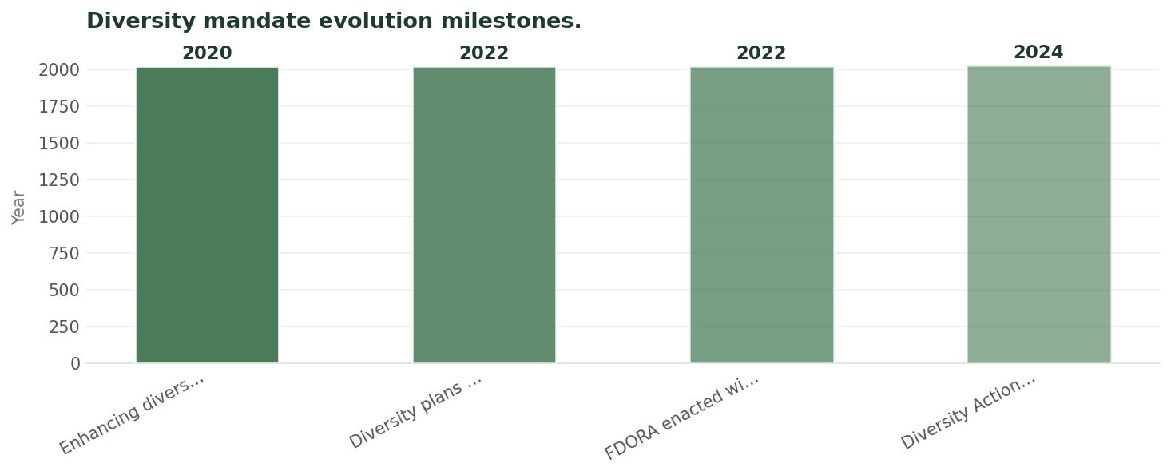
Diversity Mandate Evolution Milestones
Data visualization from document analysis
📊
6

Slide 7
Industry Response to Mandates
01
02
03
04
05
Epidemiological Data
AI-Driven Eligibility
Shared Infrastructure
Digital Divides
Regulatory Compliance
use of epidemiological data to prioritize enrollment goals
use of AI-driven eligibility to reduce burdens and costs
use of shared infrastructure to reduce costs and improve efficiency
addressing digital divides and biases in recruitment
ensuring regulatory compliance in diverse recruitment
7

Slide 8
Government Incentive Programs vs Sponsor Costs
GOVERNMENT INCENTIVE PROGRAMS
SPONSOR COSTS
Incentive Programs: government incentive programs to support diverse recruitment
Compliance Costs: compliance costs for sponsors in diverse recruitment
Cost Savings: cost savings for sponsors through diverse recruitment
Enrollment Goals: enrollment goals for sponsors in diverse recruitment
Regulatory Risk: regulatory risk for sponsors in diverse recruitment
Budget Pressures: budget pressures for sponsors in diverse recruitment
8

Slide 9

Digital Platforms
1
use of digital platforms to enhance recruitment
Technology Solutions for Diverse Recruitment
AI-Driven Tools
2
use of AI-driven tools to improve eligibility and enrollment
Data Analytics
3
use of data analytics to track recruitment and enrollment
Virtual Trials
4
use of virtual trials to increase accessibility and diversity
Patient Engagement
5
patient engagement and retention strategies
9

Slide 10
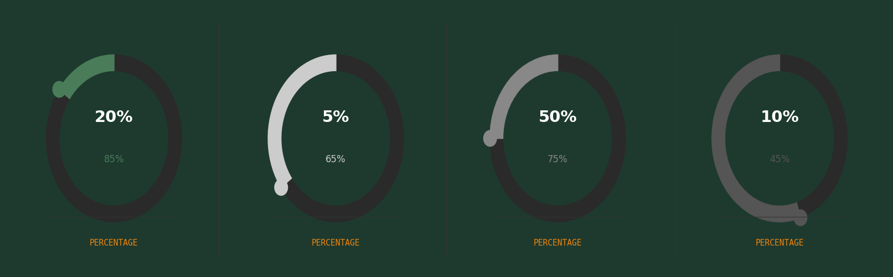
Economic Impact Analysis
10

Slide 11

Regulatory Compliance
1
ensuring regulatory compliance in diverse recruitment
Balancing Regulatory Requirements with Economic Realities
Economic Pressures
2
managing economic pressures in diverse recruitment
Enrollment Goals
3
achieving enrollment goals in diverse recruitment
Patient Engagement
4
patient engagement and retention strategies
Sustainability
5
ensuring sustainability in diverse recruitment
11

Slide 12

Conclusion
→
Diversity in Clinical Trials: importance of diversity in clinical trials
→
Regulatory Compliance: ensuring regulatory compliance in diverse recruitment
→
Economic Pressures: managing economic pressures in diverse recruitment
→
Enrollment Goals: achieving enrollment goals in diverse recruitment
→
Sustainability: ensuring sustainability in diverse recruitment
12

Slide 13

Future Outlook
→
Increased Diversity: increased diversity in clinical trials
→
Improved Enrollment: improved enrollment rates for diverse populations
→
Reduced Costs: reduced costs for sponsors through diverse recruitment
→
Enhanced Patient Engagement: enhanced patient engagement and retention strategies
13

